Slide 1
COP3503
Passing Data by Reference and by Pointer

Slide 2


The Word “Stack” in Different Situations
A location in memory tracking stack frames
The Stack, part of the amazing duo, Stack and Heap
A list of functions currently executing in a program
The call stack, which is stored on The Stack
A last-in, first-out data structure
class Stack {}; (More on this later)
Notes:
The word stack can mean several different things in programming, depending on the context.
[CLICK]
The first of these is what we’ll be looking at today, which is a region of memory that is used to track information called stack frames. The Stack, as this region is called, is typically discussed along with its counterpart, the Heap.
[CLICK]
Another common use of the term stack is the call stack. This is a list of functions that have been called in a program and are in the process of executing. We’ll look at this more in just a little bit.
[CLICK]
Lastly we can create a class to store and retrieve data in a specific way, and we would call that class Stack. An instance of this class would be A stack, as opposed to THE stack. We’ll look at the Stack class at a later time.
[NEXT SLIDE]

Slide 3
The Stack
6th item added to the stack, first one to be removed
Summary
The stack is a region of memory that tracks stack frames.
A stack frame is a chunk of memory that contains the information necessary to execute a function:
Memory for variables created in that function
Memory for passed-in parameters
Memory address of previous stack frame
The ordering of a stack is last-in, first-out.
1st item added to the stack, last item to be removed
Similar to a stack of books, or a deck of cards
Notes:
The stack is a small part of memory, often just a few megabytes in size, that keeps track of something called a stack frame.
[CLICK]
A stack frame is chunk of memory that contains information necessary to execute a function:
[CLICK]
This includes the memory for local variables created in that function
[CLICK]
The memory for any parameters the function accepts
[CLICK]
And also the memory address of a previous stack frame, so when the function ends, the previous function can resume.
[CLICK]
The ordering of a stack is what we call last-in, first-out. Similar to a stack of books or a deck of cards, the last to go “into” the stack, or placed on top of it, is the first one to go “out” of the stack, or removed from the top.
[CLICK]
If were creating physical stack of items, like a deck of cards, the first card in the deck is on the bottom, with every other card going on top of it. Since we don’t normally draw cards from the bottom of a deck, the card that we add first, will be drawn last.
[CLICK]
Every time we add a new card, it gets placed on top of the deck. If we had a total of 6 cards, the 6th card is the last one added. Since we draw from the top, this will also be the first one to get removed from the deck. This is last-in, first-out ordering.
[NEXT SLIDE]

Slide 4
Call Stack Example
A stack frame for main() is pushed onto the stack.
The Stack
int main()
{
Initialize(1280, 720);
Run();
return 0;
}
Initialize(1280, 720)
main()
Notes:
Let’s take a look at how the call stack might function as our program runs. Here we have an empty stack, and a simple program that calls two functions.
[CLICK]
Main() is a function itself, and even though we don’t call it explicitly, it GETS called as the entry point of our program. As far as our code is concerned, main() should always be first, and at the bottom of the stack. The terminology used for adding something to a stack is push, and so a stack frame with the details of the main() function is pushed onto the stack.
[CLICK]
When main() calls the Initialize() function, another stack frame is created with the details of this function call, and that’s also pushed onto the stack.
[NEXT SLIDE]

Slide 5
Initialize() Executes…
The Stack
When this function is finished, it gets popped off the stack (i.e., it gets removed).
void Initialize(int winX, int winY)
{
CreateWindow(winX, winY);
LoadModels();
LoadTextures();
LoadSounds();
}
Execution of the previous function resumes where the last function left off…
CreateWindow(1280, 720)
Initialize(1280, 720)
main()
Notes:
Now let’s say the Initialize() function is broken into several parts, each of which is contained in its own function.
[CLICK]
Each of these functions, when called, will get a stack frame placed on the call stack, starting with the CreateWindow() function.
[CLICK]
Once this function has finished executing, it gets removed from the call stack, and the program resumes. This is referred to as popping something off of the stack.
[CLICK]
With the call to CreateWindow() popped off, the program resumes its execution in the Initialize() function.
[NEXT SLIDE]

Slide 6
Continuing On…
The Stack
void Initialize(int winX, int winY)
{
CreateWindow(winX, winY);
LoadModels();
LoadTextures();
LoadSounds();
}
LoadModels()
Initialize(1280, 720)
main()
Notes:
The next line of code in the Initialize() function is a call to the LoadModels() function, and a stack frame for that is pushed onto the call stack. Let’s see what’s inside that function.
[NEXT SLIDE]

Slide 7
Loadmodels() Is Put on the Stack and Executes…
The Stack
void LoadModels()
{
LoadEnvironmentModels();
LoadPlayerModels();
}
LoadEnvironmentModels()
LoadModels()
Initialize(1280, 720)
main()
Notes:
LoadModels() is executing on top of the stack, and inside it are two more function calls.
[CLICK]
When the first one is called, a stack frame is created and pushed onto the stack. Let’s assume there are no other function calls in there, and so the stack doesn’t have anything else pushed onto it. When the function ends,
[CLICK]
it gets popped off the stack, and the next line of code in LoadModels() is called, which just so happens to be another function call. When the next function is called, it gets pushed onto the stack.
[NEXT SLIDE]

Slide 8
Loadmodels() Continues…
The Stack
void LoadModels()
{
LoadEnvironmentModels();
LoadPlayerModels();
}
LoadPlayerModels()
LoadModels()
Initialize(1280, 720)
No more code to execute, time to pop LoadModels().
main()
Notes:
This process continues with the next line of code in the LoadModels() function.
[CLICK]
Add a stack frame to the stack, execute it, and pop it off once the function has done whatever it’s supposed to do.
[CLICK]
Once this last function is finished, the LoadModels() function has run its course, and will also be popped off the call stack.
[NEXT SLIDE]

Slide 9
Loadmodels() Is Finished, Move Down the LIne
The Stack
Etc… As a program runs, the stack is constantly “growing” and “shrinking”.
It’s actually just using more (or less) of the block of memory that is “the stack”.
void Initialize(int winX, int winY)
{
CreateWindow(winX, winY);
LoadModels();
LoadTextures();
LoadSounds();
}
LoadTextures()
Initialize(1280, 720)
main()
Notes:
Our program returns to the Initialize() function, and since all of that just took place inside of LoadModels(), our program now moves to the next line of code.
[CLICK]
The LoadTextures() function is put onto the call stack, just like any other function call, and the process continues.
[CLICK]
As a program runs, we might say the stack is growing and shrinking as stack frames are pushed onto it and popped off of it.
[CLICK]
Technically that’s not quite true. The reality is that the amount of stack space that’s being utilized is increasing or decreasing. The size of the stack is likely going to remain the same throughout our program’s lifetime.
[NEXT SLIDE]

Slide 10
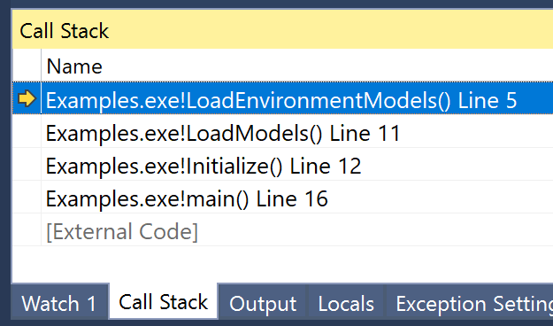
The Call Stack in an IDE
The current function…
…which was called by this function…
…which was called by this function…
…which was called by main().
The call stack provides information about the order of operations
Notes:
If we’re debugging a program, being able to view the current call stack can be very helpful. If we were to write a simple program that used the function calls we were just talking about, and we paused at a breakpoint, we might see something like this.
In Visual Studio this is accessible by clicking on the Debug menu, then clicking Windows and finally Call Stack. Other IDEs will have a similar feature.
[CLICK]
Even if we knew nothing else about the program and how each function works, we know from this window that the current function being called is LoadEnvironmentModels(). Because this is a call stack, [CLICK] we know that this function was called by LoadModels(), [CLICK] which in turn is being called by Initialize(), [CLICK] which is called by the program’s main() function.
[CLICK]
The call stack is very helpful at telling you the order of what’s happening in a program, but not necessarily how those steps are actually taking place. Still, it’s a useful tool you should get familiar with.
[NEXT SLIDE]

Slide 11
Stack Memory Is “Churned” Over Time
After a function terminates, any stack variables are still in memory… at least temporarily.
Another function call does not allocate new memory, it just overwrites stack memory.
Notes:
As our program runs, and functions are pushed onto the stack, executed, and then popped off, the amount of stack memory used will fluctuate.
[CLICK]
When functions get popped off the stack, any variables they created are still on the stack, and still exist in memory.
[CLICK]
If we call another function, that function will essentially use the “first available” memory for its stack frame. A new function call doesn’t create or allocate any NEW memory, just uses what was already allocated for the stack. It’s kind of like using a dry erase board and not erasing it as soon as you’ve finished. You can still use the board later, but until you do, whatever you wrote is still there.
[NEXT SLIDE]

Slide 12
Stack Frame Visualized
void Bar(int count)
{
int* ptr = new int[count];
double pi = 3.14f;
OtherFunction(pi, ptr);
}
void Foo()
{
int x = 5;
int y = 10;
int z = 12;
Bar(10);
}
int main()
{ Foo(); }
Local variables (if any)
Frame for OtherFunction()
Previous function: Bar()
ptr
pi
ptr
Local variables
Frame for Bar()
pi (3.14f)
Previous function: Foo()
Previous function
count = 10
Parameter
x (5)
y (10)
Local variables
Frame for Foo()
z (12)
Previous function: main()
Pointer to previous function
Notes:
The word stack frame has been mentioned quite a few times, let’s look at a visual example of what they might contain. Keep in mind this may not be exactly how they’re implemented on any given platform, but it’s a good general description. We have some example code over here with a couple of functions along with some variables and parameters. Let’s first look at the Foo() function.
[CLICK]
A stack frame for the Foo() function might look something like this. We have a spot in memory for each of the 3 local variables declared in the function, and there’s also a pointer to the function that called Foo(), so our program knows where to go once Foo() has finished.
[CLICK]
The Bar() function will also also have memory for its local variables, and a pointer to the function that previously called it (which is Foo(), in this example). It also has a small amount of memory for the “count” parameter. The parameter is data that needs to be stored in memory just like anything else.
[CLICK]
The frame for this Other Function will have a similar structure. Given the code we have, we don’t know exactly whether or not it has any local variables declared in it. If it did, they would be part of the stack frame. It will also have a pointer to the previous function that called it (which is Bar(), in this example). And it will have memory for the two parameters, which Bar() sent arguments for.
[NEXT SLIDE]

Slide 13
Stack Frame Visualized
Size of a stack frame:
The size of any variables declared, plus pointers to previous functions, plus the size of parameters
Local variables (if any)
Frame for OtherFunction()
Previous function address
ptr
pi
ptr
Local variables
pi (3.14f)
The size is determined by the compiler during the build process.
Frame for Bar()
Previous function address
Previous function
count = 10
Parameter
x (5)
y (10)
Local variables
At runtime, these stack frames get pushed or popped.
Frame for Foo()
z (12)
Previous function address
Pointer to previous function
Notes:
So just how big is any one stack frame? Generally speaking, the size of a stack frame [CLICK] will be the sum of the size of any local variables, plus the size of the pointer to the previous function, plus the size of any function parameters. It’s like making a custom box exactly the size of some object. Every box is slightly different, according to the object you’re putting into it.
[CLICK]
The size of these stack frames is ultimately determined by your compiler. When you build your code, part of that process is creating stack frames based on how your functions are written.
[CLICK]
When your program runs, stack frames of the appropriate size are pushed to, or popped from, the stack.
[NEXT SLIDE]

Slide 14
Stack Frame Visualized
Stack pointer
A stack pointer points to the current stack frame.
Local variables (if any)
Frame for OtherFunction()
Previous function address
ptr
pi
Stack pointer
The pointer moves to different addresses as functions are called (or as they end).
ptr
Frame for Bar()
pi (3.14f)
Previous function address
count = 10
Moving this pointer is very fast, and takes almost no time at all
x (5)
y (10)
Frame for Foo()
z (12)
Previous function address
Notes:
The stack makes use of something called a Stack Pointer to do its job correctly.
[CLICK]
The stack pointer indicates where the current stack frame resides, in stack memory
[CLICK]
As functions are called (or as they end), this pointer moves up or down to different memory locations. It can seem like the stack is “growing” or “shrinking” as this pointer moves.
[CLICK]
Moving this pointer around is very fast, much faster than allocating new memory. We’ll look at dynamic memory allocation soon enough!
[NEXT SLIDE]

Slide 15
Stack Memory Allocations May Be Reversed
main()
High Memory Address
We may think of a stack as growing “up” (i.e., stacking books).
Initialize()
In practice it may be the opposite:
the stack grows “down”.
LoadModels()
LoadEnvironmentModels()
Subsequent frames are added to lower addresses.
Low Memory Address
Notes:
We often talk about a stack as growing upward, like a physical stack of books or a deck of cards.
[CLICK]
In practice, however, a stack’s memory may work in the opposite way, by growing DOWNward.
[CLICK]
The first frames added to the stack are in higher memory addresses, and later frames that get added have lower memory addresses.
[NEXT SLIDE]

Slide 16
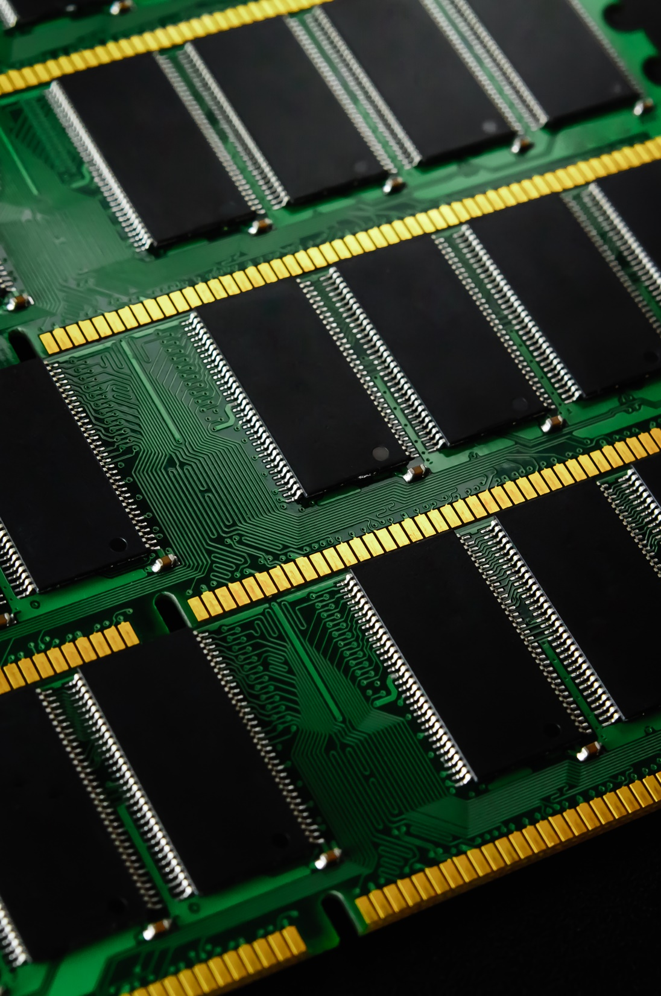
Stack Memory Is Limited
Depends on the operating system, possibly compiler settings
Typically small, only a few megabytes in size
You can still create a lot of data in a few megabytes
1 megabyte can be ~250,000 integers, ~125,000 doubles.
This can affect how you create objects in your code.
Too much data on the stack? You can cause a stack overflow error.
Notes:
Stack memory is a limited resource in our program. The exact amount of memory can vary, and could be set by a combination of your operating system and/or compiler settings.
[CLICK]
Generally, the stack is pretty small, only a few megabytes of memory. Overall, this is tiny compared to how much memory our entire computer has. That said, with only a few megabytes you should still create hundreds of thousands of variables if you needed to.
[CLICK]
Because the stack is a limited resource, we often have to write our code in ways that doesn’t exceed that limitation.
[CLICK]
If we ever do exceed the limits of the stack, we’ll encounter a catastrophic error called stack overflow.
[NEXT SLIDE]

Slide 17
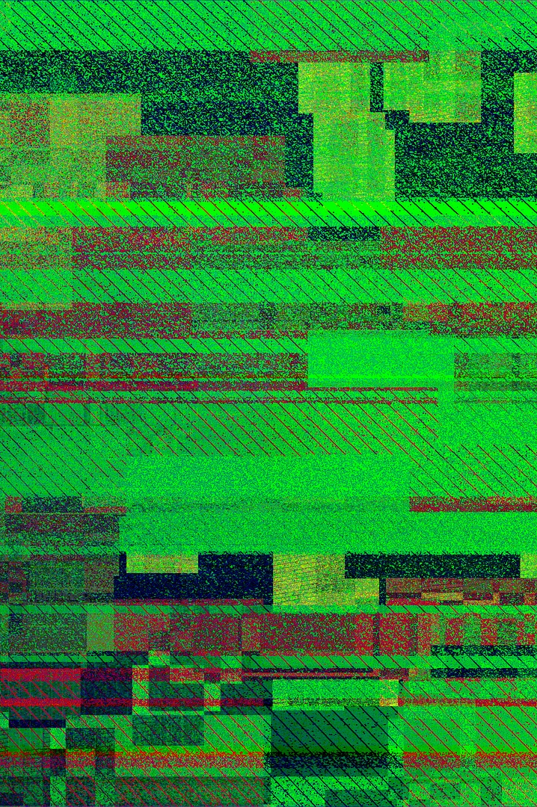


Stack Overflow Error
Paperclips
Tiny, lightweight, but in massive quantities…
Water
Pour a gallon of water into a glass that holds less than a gallon…
Too much memory allocated on the stack
Every variable occupies some amount of memory.
Every function call occupies some amount of memory.
It all adds up!
Notes:
The essence of this error is simple: Our program has tried to use more memory than our stack has.
[CLICK]
Every variable occupies some amount of memory. Every function call creates a stack frame that takes up some amount of space. Any one of these may be pretty small, but it can add up very quickly.
[CLICK]
Think of something small, like a paperclip. One of those weighs practically nothing. Two? Ten? No big deal. What about a thousand? A million? Now we’re talking about real weight that could cause some problems if we don’t handle it properly.
[CLICK]
For another analogy, think about trying to pour a gallon of water into a container than can hold less than a gallon. At some point, the second container fills up, and the excess spills out. In computer terms, spillage is a program that stops working!
[NEXT SLIDE]

Slide 18
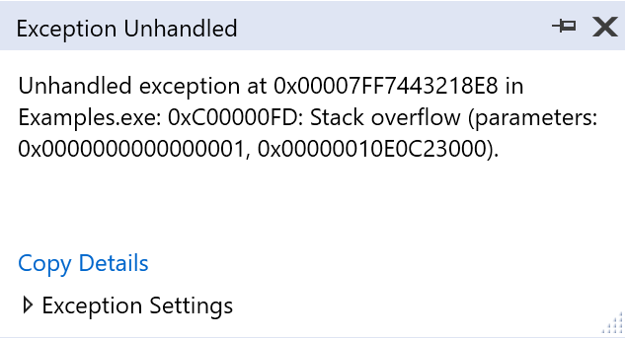
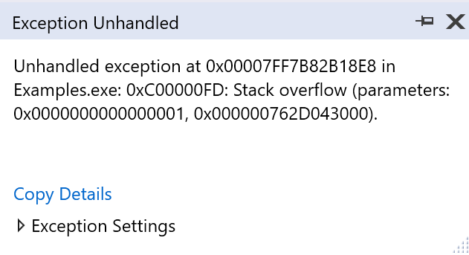
Stack Overflow
Having 1 large variable or many smaller variables doesn’t matter: Try to use too much memory, and your program breaks.
int main()
{
int array1[75000];
int array2[75000];
int array3[75000];
int array4[75000];
return 0;
}
1 int is typically 4 bytes
4 * 75000 = 300,000 bytes, or 300 kB
300 kB * 4 = 1.2MB, larger than the stack in this example
int main()
{
int bigArray[300000];
return 0;
}
Same number of integers, same memory footprint
Notes:
In this example, we have 4 separate variables, each of which is an array of 75000 elements.
[CLICK]
Integers are typically 4 bytes in size, so 75000 of them would be 300 kilobytes.
[CLICK]
4 of these arrays would be just over a megabyte, which in this case is too much for our stack to handle.
[CLICK]
If we run the program, we get a stack overflow error. If you try to allocate memory you don’t have, your program will terminate.
[CLICK]
If we changed things a bit, and made a single array containing 300,000 integers, we would end up with the same result. [CLICK] It’s the same amount of memory, and if we run the program, [CLICK] the same error occurs.
[CLICK]
Whether we have one large variable or many smaller variables, we can’t exceed the amount of memory our stack has. If we do, we’ve got a problem!
[NEXT SLIDE]

Slide 19
Stack Overflow From Recursion
Factorial(int value = -2)
Error: Stack overflow!
Stack memory
Factorial(int value = -1)
Factorial(int value = 0)
int Factorial(int value)
{
return value * Factorial(value - 1);
}
int main()
{
cout << Factorial(5);
return 0;
}
Factorial(int value = 1)
Factorial(int value = 2)
Factorial(int value = 3)
Factorial(int value = 4)
Each function call goes onto the call stack and takes up some amount of stack memory.
Factorial(int value = 5)
main()
Notes:
Recursion is an easy way to hit a stack overflow error if we aren’t careful. Here we have a simple (and broken!), example of recursion.
[CLICK]
And here we have our dear friend, Stack. The stack starts off with main() as the first stack frame, taking up a small amount of memory.[CLICK] When we call the Factorial function with the number 5 as an argument, a stack frame is created with that information and pushed onto the stack.
[CLICK]
Because we’re using recursion, this Factorial() function will call itself with the value of 4, and a new stack frame is pushed. Then another, and another, and another…[CLICK]
Each function call takes up some amount of memory, and eventually, we fill up the stack. However, our Factorial() function will still call itself, passing the number -2 as an argument. [CLICK]
Doing so causes an error, as there is nowhere for this memory to go! We’ve tried to pour too much water into a cup, and the excess spills all over the place. We don’t have to worry about our computer spilling bytes anywhere, but the program will terminate.
[NEXT SLIDE]

Slide 20
The Stack Is a Small Amount of Memory
Factorial(int value = 2)
Error: Stack overflow!
Stack memory
Factorial(int value = 3)
int Factorial(int value)
{
int bigArray[1000];
return value * Factorial(value - 1);
}
void SmallFunction()
{
Factorial(5); }
int main()
{
SmallFunction();
return 0;
}
Functions with lots of data, on the other hand…
Factorial(int value = 4)
Factorial(int value = 5)
…use more space on the stack.
Stack frames are typically small; a call stack might store dozens, or hundreds of them.
SmallFunction()
main()
Notes:
Here’s a similar example, but with a function that has a larger stack frame—nevermind that we aren’t using that array of 1000 integers for anything, just imagine it’s really important data. We’re using a little bit of memory on the stack, and then we call the Factorial() function.
[CLICK]
For the most part stack frames are small, and a call stack can handle lots of them.
[CLICK]
However, if a function uses a lot of data, even temporarily… [CLICK]
… it will use more space on the stack. In this case, calling the Factorial() function just a few times will be enough to cause a stack overflow error, for the same reasons as before: We’ve tried to use more resources we have.
[NEXT SLIDE]

Slide 21
What If You Need Large Amounts of Memory?
Then, you dynamically allocate memory on the heap.
Automatic storage
Dynamic storage
This data is allocated on the heap instead of the stack.
void SomeFunction()
{
int bigArray[300000];
// Do some stuff
}
void SomeFunction()
{
// 1. Allocate memory
int* bigArray = new int[300000];
// 2. Do what you need to do
// 3. Deallocate memory
delete[] bigArray;
}
bigArray is on the stack (all local variables are), but it points to memory on the heap.
Notes:
So what do we do if our program actually needs that much memory? In this case, we have to use something called dynamic memory, and make use of another region of memory, the Heap.
[CLICK]
First, let’s look at what we were trying to do that was problematic. We want a big array of 300,000 integers, but we can’t have it, because it’s too large for the Stack to handle. In C++, this kind of variable usage (the same you’ve done many times before) is sometimes referred to as automatic storage. Unless we say otherwise, the compiler creates instructions to put this memory on the stack by default.
[CLICK]
What we want is this alternative, something called dynamic storage. This is working toward the same end goal, but there are more steps involved.
[CLICK]
By using the new keyword, we’re indicating that we want to put this huge array of integers on the heap, instead of the stack. We have to specifically indicate we want to put this memory on the heap. We also have to later free up that memory using the delete keyword, but we’ll cover that in more depth at another time.
[CLICK]
The variable bigArray is created on the stack. This is because local function variables we create are ALWAYS put on the stack. This variable is actually a POINTER—notice the asterisk next to the int data type? We’ll talk more about pointers in another video, but this means that bigArray is like directions to the data, but isn’t actually the data itself. The real data is on the heap.
[NEXT SLIDE]

Slide 22
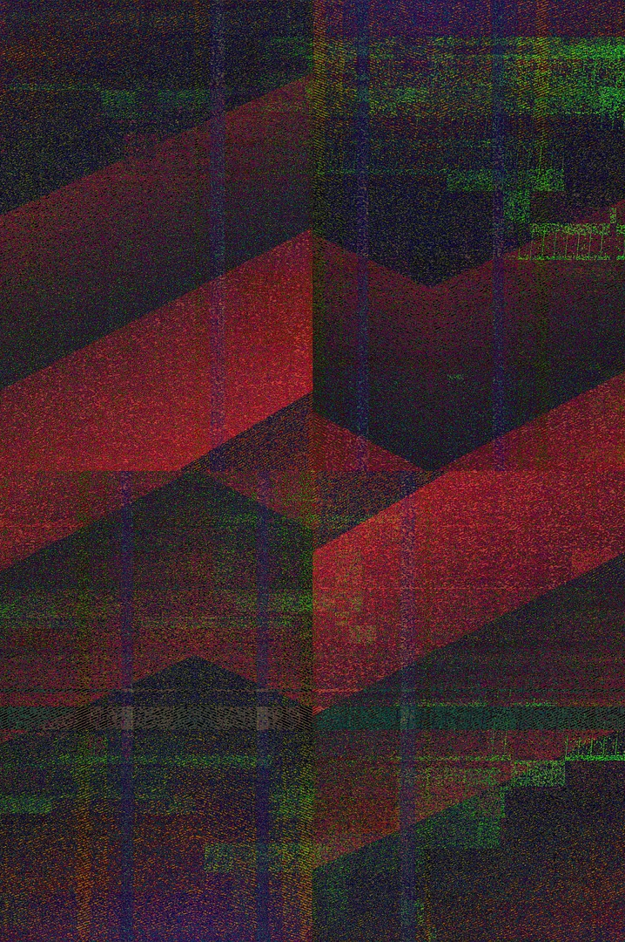
The Heap Is for Dynamic Memory
The heap is for data we can’t put on the stack:
Large amounts—no stack overflow!
Data we don’t want to “fall out of scope”
Data whose size we don’t know at compile time
Heap memory is allocated, or reserved with new
It must be deallocated or freed with delete.
Much slower than the stack
But it must be used in many cases.
Use the stack when you can, the heap when you must.
Notes:
The heap is where we store data that, for one reason or another, can’t be put onto the stack.
[CLICK]
This could be large amounts of data—using the heap avoids the stack overflow issues we just looked at.
[CLICK]
We might dynamically allocate data we don’t want to fall out of scope. We could create data in one function, and use it in another. We’ll see plenty of examples of that later on.
[CLICK]
We can also use dynamic memory to allocate space whose size we don’t know when we’re writing code. If we ask for user input, and then create some amount of data based on that input, we can’t know what that number is until the program runs, but that comes after we’ve written our code.
[CLICK]
Heap memory has to manually allocated with the new keyword, and it must also be deallocated, or freed, with the delete keyword. If we don’t delete memory properly, we’ll get something called a memory leak. Don’t worry about that just yet, we’ll cover that another time. I know I keep saying that, but in order to understand more complex topics like pointers and dynamic memory, there are a lot of closely-related topics you need to understand first.
[CLICK]
The heap operates much more slowly than the stack does, but in many cases we don’t have a choice. In fact, many programming concepts like data structures would be impossible without it. If we can use the stack, we should. If we can’t, then we have to use the heap.
[NEXT SLIDE]

Slide 23
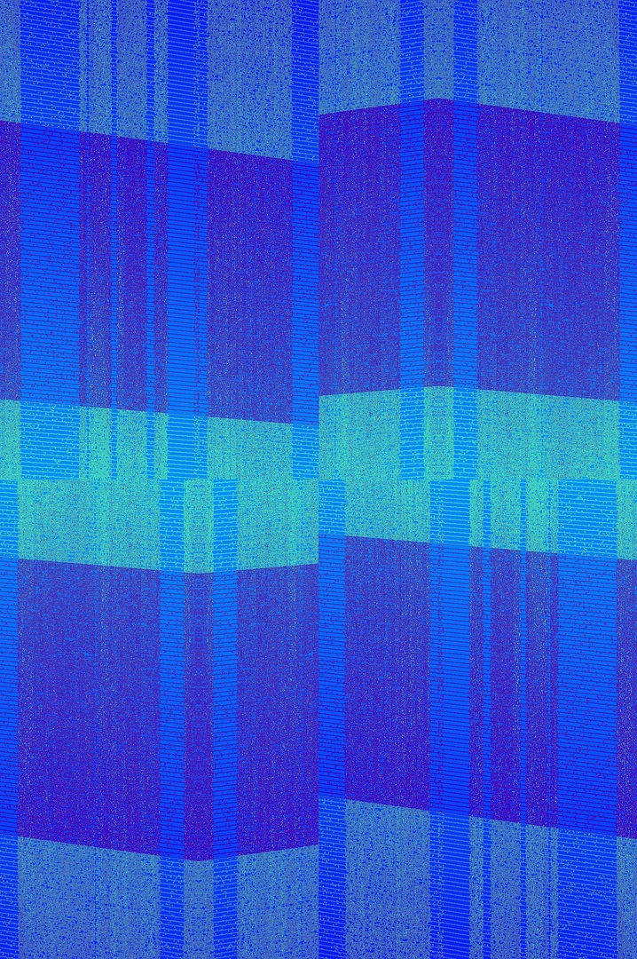
Heap and the “Free Store”
Heap and Stack are general computing concepts.
The C++ standard doesn’t mention “heap” and “stack” anywhere.
You may hear the heap called the free store.
The C++ standard uses automatic and dynamic storage.
Conceptually, the same thing:
Stack: Automatic storage
Heap: Dynamic storage
Notes:
As far as terminology is concerned, the heap and the stack are general computing concepts. Not every programming language implements them in exactly the same way.
[CLICK]
The C++ standard doesn’t use the terms heap or stack anywhere, though the language implements something that does more or less the same thing. In C++, you may sometimes hear the heap referred to as the free store.
[CLICK]
The C++ standard instead uses the terms automatic storage and dynamic storage.
[CLICK]
This is essentially the same thing as the stack and the heap. The stack is automatic storage, while the heap is for dynamic storage.
[NEXT SLIDE]

Slide 24
Heap and Stack Memory Grow Toward Each Other
main()
High Memory Address
Initialize()
Stack allocations move toward the heap.
LoadModels()
LoadEnvironmentModels()
Unused Memory
Heap allocations move toward the stack.
Heap Memory
Low Memory Address
Notes:
The stack is a specific region of memory, and the heap is another region of memory. Though it may vary from one platform to another, generally the stack and heap exist at opposite ends of memory, and grow toward each other as more memory is allocated in that region.
[CLICK]
The stack will typically start at a high memory address, and as it grows, new allocations are given lower memory addresses.
[CLICK]
The heap, on the other hand, will typically start at lower memory addresses, and new allocations will be given higher memory addresses, growing “upward”.
[NEXT SLIDE]

Slide 25
Stack Variables vs. Heap Variables
All local variables are on the stack (in automatic storage).
All dynamically allocated memory is on the heap.
void Foo()
{
int x; // stack
int* ptr = &x; // stack pointer, pointing to memory on the stack float* ptr2; // stack
double* someDoubles = new double[25]; // someDoubles is on the stack
}
Pointer, on the stack
Allocated memory, on the heap
Notes:
It’s important to know where variables and data end up in memory. In a function, ALL local variables are on the stack. Even if we’re using pointers, the pointer itself is on the stack, regardless of what it points to.
Here we have a few different variables: x, “ptr”, “ptr2” and “someDoubles” are all variables we’ve created, and these get put on the stack. They’re part of the stack frame that is generated for every call to the Foo() function.
[CLICK]
This allocation, however, because it’s using the “new” keyword, will go on the heap. This allocation is essentially calling a function called new(), which returns a pointer to the location on the heap where that memory can be stored. It’s kind of like burying some pirate treasure, and then making a map to that location.
[CLICK]
We can store that treasure map on the stack, even though the map leads us to the heap. We’ll talk more about pointers and dynamic allocation later. For now, we’re just covering the broad ideas behind the Stack and the Heap.
[NEXT SLIDE]

Slide 26
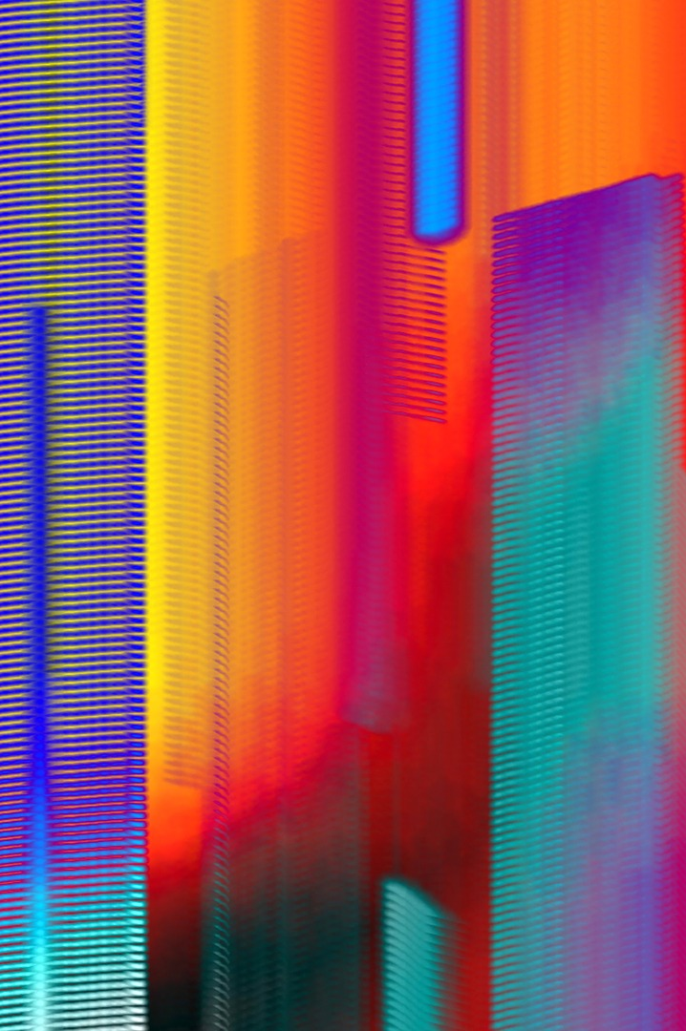
When Does Heap Data “Disappear”?
Stack-based variables get “deleted” when they go out of scope.
When their function comes off the call stack
The space they once occupied will later be overwritten.
Stack-based memory is suitable for temporary data.
Create some variables, use them, then forget about them
Heap data lives on… “forever”.
It never falls out of scope.
We’re writing simple programs so far… but what about a program that runs for hours? Days?
You must delete it.
Most operating systems will free up memory when a program ends.
Notes:
We’ve talked before about variables falling out of scope. When a function ends, its stack frame is popped off the stack. The memory it once occupied is still there, and the values stored there are likely the same, until they get overwritten by something else.
[CLICK]
Stack-based memory is suitable for temporary data. Create the data we need, when we need it, and then forget about it—it will get freed up automatically.
[CLICK]
Heap data, on the hand, basically lives on forever, or as long as our program is running. [CLICK] Heap data never falls out of scope, and it’s up to the programmer to reclaim that memory themselves.
Your operating system will PROBABLY free that memory once your program ends, but that’s not necessarily a guarantee.
[CLICK]
Also, while we will be writing fairly simple programs, what if you write a program that is running for hours, or days at a time? You may not be able to rely on something else cleaning up your mess for you. This can be a major programming challenge, and we’ll look examples of this later.
[NEXT SLIDE]

Slide 27
Recap
Stack
Heap
Short-term storage
Long-term storage (or large data storage)
Automatic memory: no new/delete required
Dynamic memory: The programmer must allocate and deallocate
Small in size
Functions and the local variables they use are placed on the stack
Large, essentially all the rest of your computer’s memory
Stack overflow errors if you try to use more than you have
Memory leaks can occur if not managed properly.
Notes:
To recap all this, the stack is used for short-term, temporary storage. [CLICK] It’s automatic storage, the default in the language, and no specific keywords or processes are required. [CLICK] The stack is generally pretty small in size, no more than a couple of megabytes. [CLICK] Local variables and stack frames are placed on the stack.
[CLICK]
It’s a limited resource, and trying to use more memory than the stack has will result in stack overflow errors.
[CLICK]
The heap is for long term storage, or possibly for storing data too large to fit on the stack.
[CLICK]
The heap is for dynamic allocations—the programmer must manually allocate and deallocate
[CLICK]
The heap is large in size; it’s essentially “all the rest” of your computer’s memory. That may be a bit oversimplified, but is close enough for now.
[CLICK]
If we don’t free up memory properly, we’ll end up with memory leaks, which can cause us to run out of memory if we’re not careful.
[NEXT SLIDE]

Slide 28

Conclusion
Placeholder for the instructor’s welcome message. Video team, please insert the instructor’s video here.
Notes:
That wraps things up for this video about the stack and the heap. Don’t worry, we’ll see be seeing plenty of them in the future. Thanks for watching, and I’ll see you next time!
[NEXT SLIDE]

Slide 29
Thank you for watching.

